Slide 1


Slide 2
Community Voluntary Organisation Support Fund (CVOS)
The Community Voluntary Organisation Support (CVOS) Fund is available to community based voluntary non-profit organisations domiciled in Central Hawke’s Bay.
It is made up of two categories –
Category 1 -A pool of $10,000 of funding to support Voluntary Organisations seeking grants for New Community Initiatives. Category 1 funding is for Community Groups who have not received funding from CVOS, or the Community Initiatives Fund previously, or from groups who have received funding but are applying for a new project.
AND
Category 2 –A pool of $20,000 for ongoing support to existing community groups who provide community services to all of Central Hawke’s Bay.
Applications open 3rd week of July every year.
For eligibility please see the Community Funding Policy

Slide 3
Community Pride and Vibrancy Fund
Supports community opportunities to create pride and vibrancy in Central Hawke’s Bay.
The fund supports projects that are an activity, programme or development that will occur in a public space and promotes our community to THRIVE.
Successful applications will result in outcomes that support our communities identity, attract people’s interest, inspire and engage people and overall, contribute to a sense of community. Applications to the fund may not always be monetary and could include the provision of material, labour or other support.
The funds available each financial year are
  Year 2 2019/20 $15,000
  Year 3 2020/21 onwards $20,000
Applications can be submitted at anytime. Applications for funding of over $5,000 go to the Strategy and Wellbeing Committee to review.
For eligibility please see the Community Funding Policy

Slide 4

Creative Communities Scheme (CCS)
The Creative Communities Scheme (CCS) provides funding to communities so New Zealanders can be involved in local arts activities.
The scheme supports a wide range of arts projects under various art forms e.g craft/object arts, dance, inter-arts, literature, Māori Arts, music, Pacific Arts, theatre and visual arts.
This is a contestable fund
There are two funding rounds per year in February and August
There is $23,490 available for distribution per annum
For eligibility please see the Community Funding Policy

Slide 5
Criteria
Access and Participation
The project will create opportunities for local communities to engage with and participate in local arts activities.
Diversity
The project will support the diverse arts and cultural traditions of local communities, enriching and promoting their uniqueness and cultural diversity.
Young people
The project will enable and encourage young people (under 18) to engage with and actively participate in the arts.

Slide 6
Sport NZ Rural Travel Fund
Application for the Rural Travel Fund is open to rural sports clubs and rural school teams with young people aged between 5 and 18 years who require subsidies to assist with transport expenses to local sporting competitions.
The following criteria will be applied:
  A school club team is defined as participating in regular local sport competition out of school time, that excludes inter school and intra school competitions played during school time; and/or
  A sports club team participating in organised, regular sport competition through club membership outside of school time.
Examples of eligible expenses include fuel costs and bus hire.
Travel to regional or national events is NOT eligible.
Applications for this fund open in November 2022

Slide 7
For more information about funding check out our website
https://www.chbdc.govt.nz/our-district/economic-development/grants/
All Application Forms can be located on the Website.

Slide 8

Environmental & Sustainability Fund
Central Hawke’s Bay District Council (Council) through its Environmental and Sustainability Strategy (the Strategy) has set an intent and direction to more purposefully control its impact on the environment and to be a leader in promoting sustainable and environmentally friendly practice in Central Hawke’s Bay. Through project THRIVE, residents voiced a want to protect and enhance the place they call home in Central Hawke’s Bay. The Strategy provides direction and guidance as to how Council will play its part and support others to play theirs including through the provision of funding.

Slide 9
Environmental & Sustainability Fund
The Environmental and Sustainability Fund seeks to support community based not-for-profit organisations or individuals that support our community to thrive.
This fund is contestable and supports projects that are an activity, programme or development that supports the objectives of the strategy and promotes our community to thrive.
Applications to the fund may not always be monetary and could include the provision of materials, labour or other support.
Funding Availability:
The fund utilises money made available by Councils National Waste Levy Income and is set at a maximum allocable amount of $20,000 per financial year .
Councils financial year is 1 July – 30 June.

Slide 10
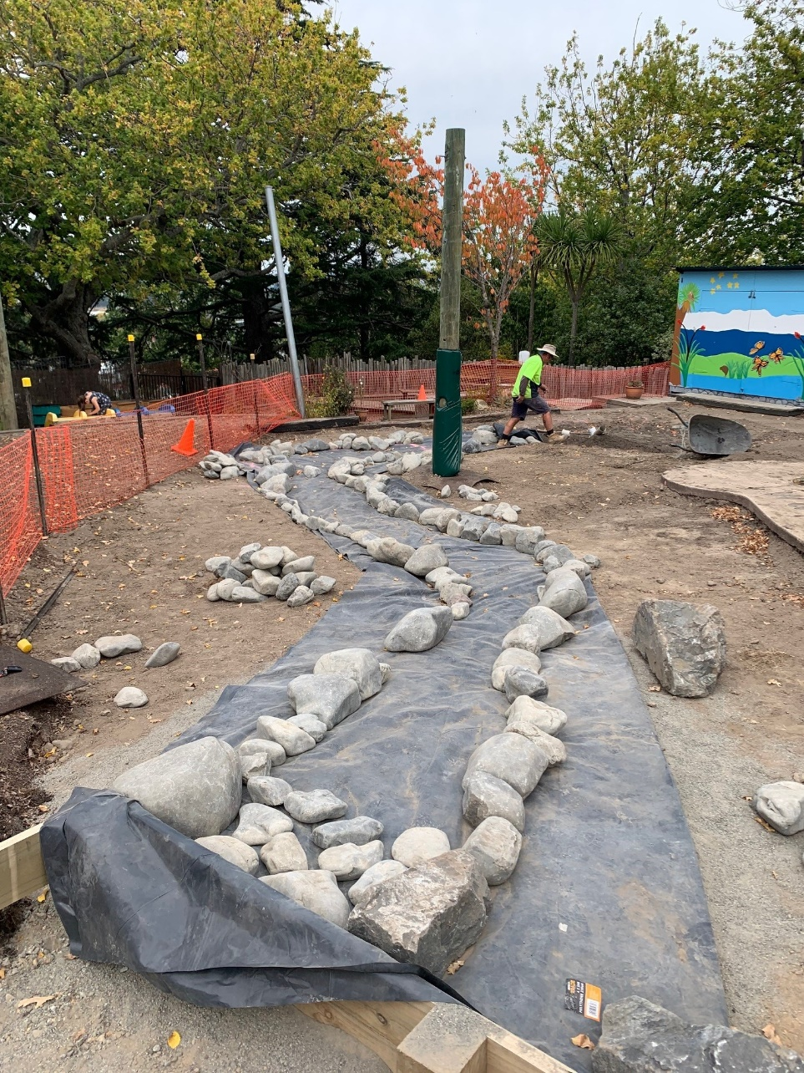
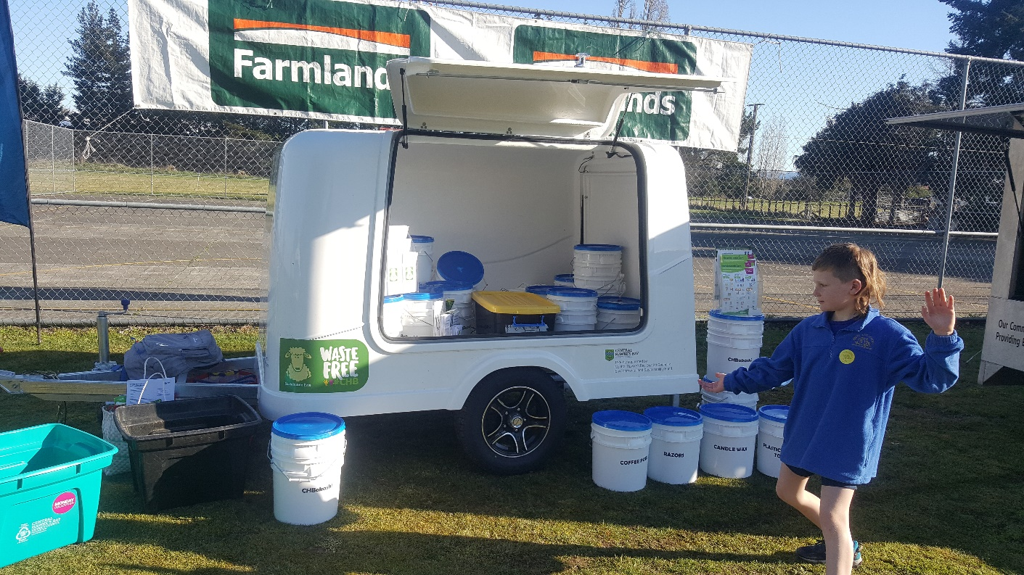
Environmental & Sustainability Fund
Successful applicants
Hunter Park Kindergarten received funding from the Environmental and Sustainability Fund for their River Play Project.
The project includes the construction of a new play river which doubles as a stormwater conveyance channel and the installation of a rain-garden at the end to filter sediment and minimise/control stormwater off site.
Sustainable Ewe
Sustainable Ewe received funding for the purchase of a trailer whose purpose is to transport buckets used in the making of Bokashi buckets.
The Great Bucket Rescue
Sustainable Ewe has had the opportunity to save hundreds of buckets from being sent to the landfill on an ongoing basis. This is something too good to pass up!

Slide 11
For more information regarding criteria and the application process, check out our website to find the Community Funding Policy:
https://www.chbdc.govt.nz/our-district/economic-development/grants/
Environmental and Sustainability Stategy and Waste Management and Minimisation Plan:
https://www.chbdc.govt.nz/our-district/environment/
Together we are: Successful environmental guardians, ensuring future generations THRIVE here!

Slide 12
Sport Hawke’s Bay

Slide 13


Tū Manawa Active Aotearoa
Notes:
Intro ourselves

Slide 14
Purpose of the fund
The purpose of Tū Manawa is to provide quality experiences that are accessible, create a life-long love of being active and meet the needs of tamariki and rangatahi.
The fund enables organisations to provide quality experiences in play, active recreation and sport for tamariki (children aged 5-11) and rangatahi (young people aged 12-18), particularly those for whom barriers cause them to be less active.
Notes:
Emphasis on need. Tamariki and rangatahi being active in a way that they want to be active. This fund reduces any barriers that are stopping those kids from being active.
Priority groups:
• Children and young people in higher deprivation communities (5-18)
• Girls and young women (5-24)
• Disabled children and young people (5-18)

Slide 15
How to apply
Talk to one of us first
www.sporthb.co.nz
  Funding
Contract between Sport Hawke’s Bay and Successful Applicant
12 months to spend funds
Online report
Notes:
Emphasis on talking to us before you apply.
Funding is available to a wide range of groups and organisations who are planning to, or already deliver, a play, active recreation or sport programme/project to help children and young people get active.
Iwi, Marae, Māori organisations
Incorporated Societies
Charitable Trusts
Regional or Local Councils
For-profit businesses/commercial organisations and social enterprises
Educational settings

Slide 16
Hawke’s Bay funding rounds
Within Hawke’s Bay we have $680,000 available to distribute per year. The distribution of these funds are split over the following rounds.
  Fast Fund – Bi-monthly round $10,000
  Full Fund – Bi-annual round $40,000

Slide 17
Tū Manawa Active Aotearoa
Central Hawke’s Bay – To Date
Aqua Management Limited | $7,336
Central Hawke’s Bay College | $3,107
Central Hawke’s Bay College | $5,000
Central Hawke’s Bay District Council | $1,100
Epic Ministries Incorporated | $5,000
Omakere School | $2,314
Omakere School | $2,800
Takapau School | $6,850
Richochet Trampoline Club | $7,100
Central Hawke’s Bay District Council | $3,524
Porangahau Country Club | $6,000
Central Hawke’s Bay District Council | $11,332
Central Hawke’s Bay District Council | $23,000
Omakere School | $5,860
St Josephs Waipukurau | $3,000
Waipukurau School | $2,500
Omakere School | $2,400
Omakere School | $1,400
The Terrace School | $10,000
Central Hawke’s Bay College | $3,275
Omakere School | $653
Pukehou School | $2,000
Horizon Basketball Trust | $6,450
VALUE APPROVED
$122,001

Slide 18

Kate Benny, Community Partnerships Advisor
kateb@sporthb.net.nz
Ryan Hambleton, General Manager
ryanh@sporthb.net.nz

Slide 19
Eastern and Central Community Trust

Slide 20

Central Hawke’s Bay
Funding Roadshow

Slide 21


Who we are…
9 Trustees, 6 staff
Last year:
$4.2M in ECCT regions
$1.6M in Hawke’s Bay
Eastern & Central Community Trust | Hawke’s Bay Funding Roadshow | April 2022

Slide 22
What we do…
Community Services & Education
Connection
Participation
Capacity Building
1. Grassroots Fund – people can access a range of activities, services, events and initiatives in their community
For example:
$1,000-$4,000 Local events, festivals, celebrations
$1,000-$5,000 Operating costs, programme delivery, coaching, mentoring, support workers, wages, salary, equipment, uniforms, H&S, shelters, power, rent, insurance, phone, etc.
$8,000-$15,000 Youth development programmes, community economic development, operating costs & volunteer capacity development.
$10,000-$25,000 Vans, astro turf, flood lights, office renovations, pool upgrade, playground
$20,000-$50,000 New roof, large building upgrades, kitchen & dining facilities, outdoor areas, Whaikairo, Tukutuku, etc.
Notes:
Grassroots Fund is about contributing to the work you are doing…
How we can help
Contribution to operating costs – roughly around 10% of local/ regional operating expenses up to $5K – includes overhead's, programmes, day-to-day activities , local events, equipment, R&M.
Contribution of 20-25% up to $50K for assets, larger R&M costs, capital items
No closing dates – except for Education (1 April and 1 Aug)
Community-led initiatives & Capacity Support
How we can help
Contribution of up to $10K per project for development or capacity support activities
In addition to operating costs - but can be increased contribution to operating costs if a development approach is embedded in the way your group works (e.g. part of your Kaupapa)
Community-led initiatives
Place-based partnerships between communities and other stakeholders
Mana enhancing approach / development approach led by community (by community, we mean “community of focus” – e.g could be community-led, youth-led, Maori development, community-led economic development, etc.)
Capacity Support
Support Organisations to strengthen themselves.
Community leadership and capacity building activities

Slide 23
What we do…
Community Services & Education
Connection
Participation
2. Community Assets & Facilities Fund – people can access a fit-for purpose community facilities.
Grants of up to $250K (GST Excl)
Projects with a Total Cost Over $300K (GST excl)
Come & speak with us early
Capital Works Closing dates: 31 July for a September Meeting (EOI approval required first)
31 January for a March Meeting
Notes:
Connection Output coming in
Facilities that enable collaborative networks & partnerships. Shared knowledge & resources. Moving from single use or single club facilities to community hubs.
Key thing is the Right facility in right place
to meet a demonstrated community need
are affordable and sustainable
Need to show us this
How we can help - two step funding process
EOI where we look at your idea against our investment criteria and help you get to a stage where you can fully cost your project
Capital Works – grants of up to $250K
Can take 3 months to hear about EOI approval! Best time to come and speak is before or early on in your feasibility work.

Slide 24
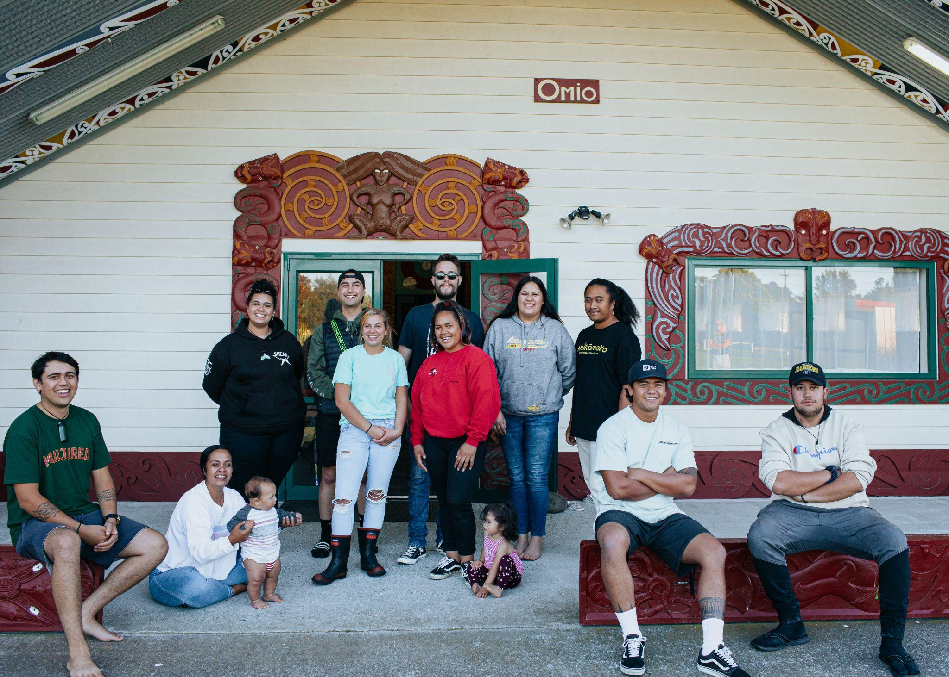
What we do…
3. Strategic Funding – funding for proven initiatives that deliver results in ECCT’s Strategic Focus areas, based on a cohesive strategy or action plan.
Focus Area: Children & Young People
Co-design of a Rangatahi Action Plan
$4M over 4 years from 1 April 2022
Notes:
Connection Output again
2018 Funding Strategy – our communities told us what was important… and children and young people where one of these focus areas
We’ve been working with Rangatahi from across our region for about 18 months

Slide 25
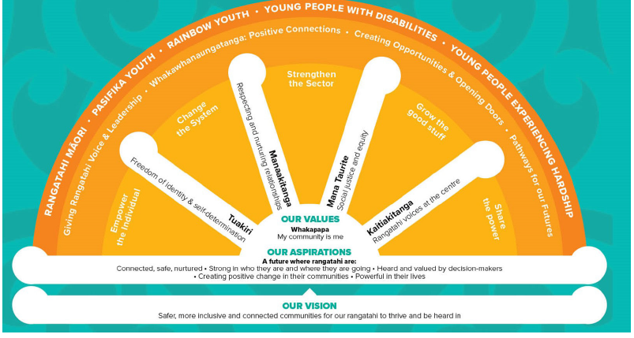
https://youtube/RtOxyiwgGts
Notes:
Current Funding opportunities:
Rangatahi-led Funding
Champions funding closed and awarded last week – Epic and He Taonga Taamata
Connection with Rangatahi Rōpū - our rangatahi keen to hear from your rangatahi
Sharing of local information about what's important to young people

Slide 26
Rose Artemiev
Community Advisor
Email: rose@ecct.org.nz
Freephone: 0800 878 720
www.ecct.org.nz

Slide 27
Department of Internal Affairs

Slide 28


Department of Internal Affairs
Community grants

Slide 29

About us
We provide support and information
about central government and
Lottery funds available to community organisations and charities.

Slide 30
Funds on offer
Community Organisation Grants Scheme (COGS)
Provides grants to community-based social services that contribute to local outcomes:
ongoing operational costs
community projects or events.
Next opening April 20, closing May 18

Slide 31
Funds on offer
Lottery Community Fund
Provides grants to help improve the quality of people’s lives in the community:
ongoing operational costs
community projects or events
minor capital works projects valued at $30,000 or less
community development costs, such as hui, training, planning, evaluation and facilitator fees.
Next opening June 22, closing 20 July
Opening 2 November, closing 30 November

Slide 32
Funds on offer
Lottery Community Facilities Fund
Provides grants to improve or build community facilities and for studies to find out if a community facility is needed and can be achieved:
e.g. stadiums, community swimming pools, skate parks, playgrounds, community halls and performing arts complexes.
Next opening July 13, closing September 7
Opening January 4, closing March 1

Slide 33
Funds on offer
Lottery Environment and Heritage Fund
Provides grants for plans, reports and one-off projects that preserve, restore and protect NZ’s natural, physical and cultural heritage e.g.:
restoring habitats and ecosystems for our native plants and animals
restoring places and structures of significance to our history
protecting cultural collections.
Opening 9 June, closing 4 August

Slide 34
Funds on offer
Oranga Marae
Provides grants for the physical and cultural revitalisation of marae as centres of Māori identity and mātauranga. The fund is provided by Te Puni Kōkiri and the Department. Grants are for:
Marae development planning
Technical or feasibility reports
Implementation of cultural or capital works on the marae.
Open ongoing, various dates for the different parts of the Fund, see website

Slide 35
Funds on offer
Lottery Minister’s Discretionary Fund
In addition to considering requests for projects that fall outside the scope of other Lottery Funds, there are four priorities that are only available through the Fund:
Overseas travel
Volunteer fire-fighting services for projects
Animal welfare projects
Training for financial planning and/or good governance (which includes an emphasis on support for children’s organisations).
Open ongoing

Slide 36
Application tips
Talk to an advisor if you have any questions about eligibility or the application process.
Keep applications clear and concise – use bullet points.
Website
www.communitymatters.govt.nz
Community Advisors
Mary.Wilson@dia.govt.nz 027 382 9726
Monteata.Lafou@dia.govt.nz 027 214 4294
Norman.Apirana@dia.govt.nz 027 205 2705

Slide 37
Hawke’s Bay Foundation

Slide 38

Our community.
Our future.
Our responsibility.
Notes:
We all need to lean in
We need to connect back with our community, and back our community
It’s about safeguarding the future for coming generations
It’s about role modelling to our children, grandchildren and others around us

Slide 39
Northland Foundation
Auckland Foundation
Acorn Foundation
(Western BOP)
A GROWING MOVEMENT
Momentum Waikato
Geyser Community Foundation (Rotorua & Taupo)
Eastern Bay
Community Foundation
Te Karaka Foundation (Taranaki)
Sunrise Foundation
(Gisborne)
The fastest growing form of philanthropy in the world
17 Community Foundations across NZ
We’ve been growing as a network in NZ since 2003
Te Awa Community Foundation (Horizons District)
Hawke’s Bay Foundation
Nikau Foundation (Wellington)
Top of the South
Community Foundation
Christchurch Foundation
Advance Ashburton Community Foundation
Aoraki Foundation (South Canterbury)
Wakatipu Community Foundation
Clutha Foundation (Clutha District)
Notes:
WHERE ARE WE?
There 17 Community foundation’s in NZ.
All major regions covered
Fastest growing form of philanthropy in the world….
Started in US 100 years ago, but established in New Zealand only 16 years ago
The Tindal Foundation instrumental in bringing the movement to New Zealand

Slide 40

What does Hawke’s Bay Foundation do?
In a nutshell: we invest donations from locals, and distribute the income gained to local charities, via a grants round, or according to the Donor’s wishes.
In 2021 we gave over $160,000 to 53 Hawke’s Bay charities.
We aim to provide long-term funding to all Hawke’s Bay charities.
We currently have $6.2 million in our Fund, with the equivalent promised in bequests.
We have 10 members on our voluntary Board, and 3 part-time staff members.

Slide 41



Slide 42
How to apply for funding
Follow us on Facebook or sign up for our newsletter via our website – you’ll be alerted when the funding round opens
Funding round opens in early May
Distributions are made in October
You must be a registered charity, with the bulk of your work benefitting the Hawke’s Bay community

Slide 43
Why set up a Community Group Fund?
After seeding your Fund with at least $25,000, you will begin receiving annual income payments of 4% of the fund’s gains.
Relax, knowing the capital – the donations – can never be touched.
Anyone can add to the fund at any time. All donations over $5 are eligible for the 33% tax credit.
We do all the administrative work. There is no need to set up a separate charitable entity or file any returns.
We will also provide marketing materials for you to promote the fund and will actively encourage both of our donor networks to donate.

Slide 44

EPIC Ministries Fund
EPIC decided to open a Community Group Fund with Hawke’s Bay Foundation
They approached their donor community, and were very surprised and pleased when a long-standing supporter of EPIC gave $50,000 to seed their new Fund
We are working with EPIC to continue to market their new Fund
They will receive a guaranteed distribution from their Fund annually

Slide 45
Ngā mihi nui ki a koutou
Thank you

Slide 46
Te Puni Kokiri

Slide 47
Papakāinga, Cadetships and Te Pū Harakeke.
Our Vision
Thriving Whānau: When whānau are thriving, so do their communities, hapū, iwi and all of Aotearoa

Slide 48
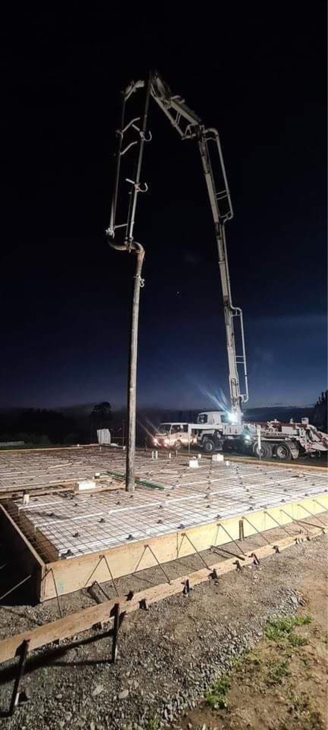
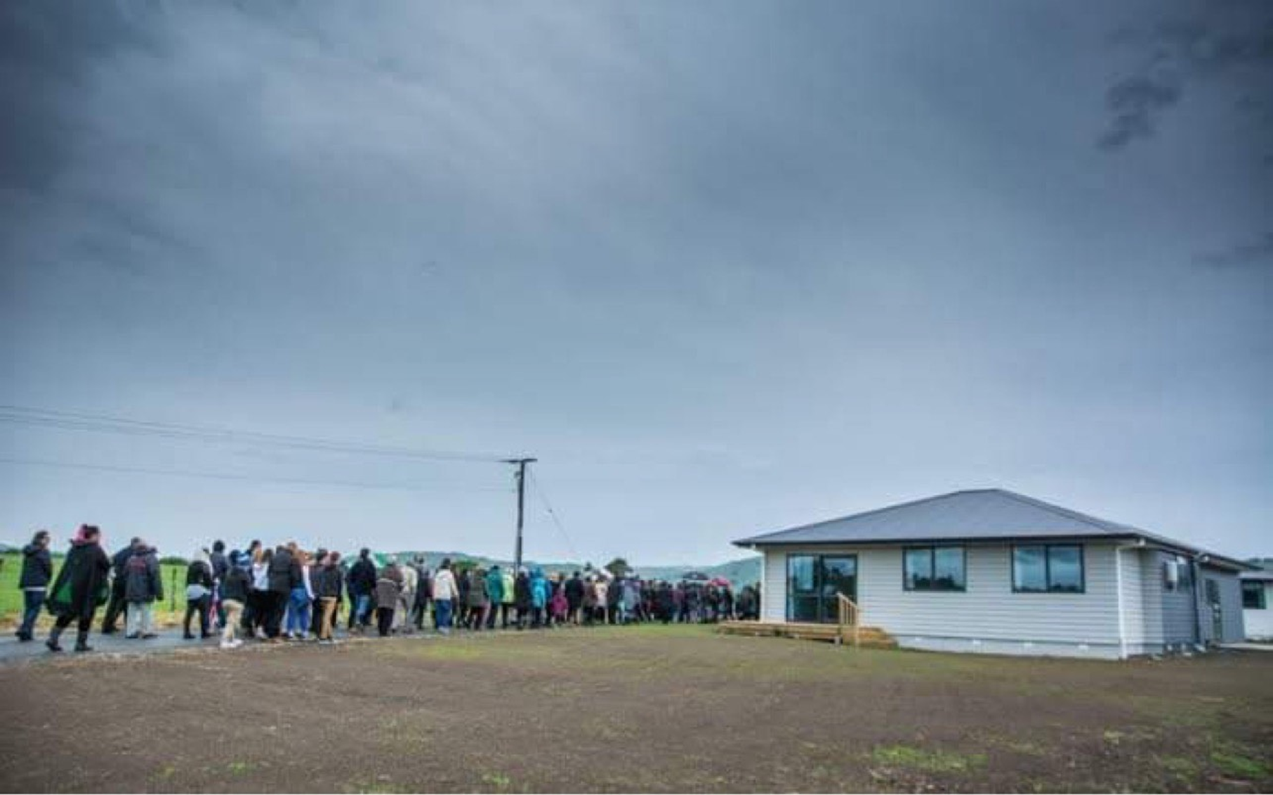
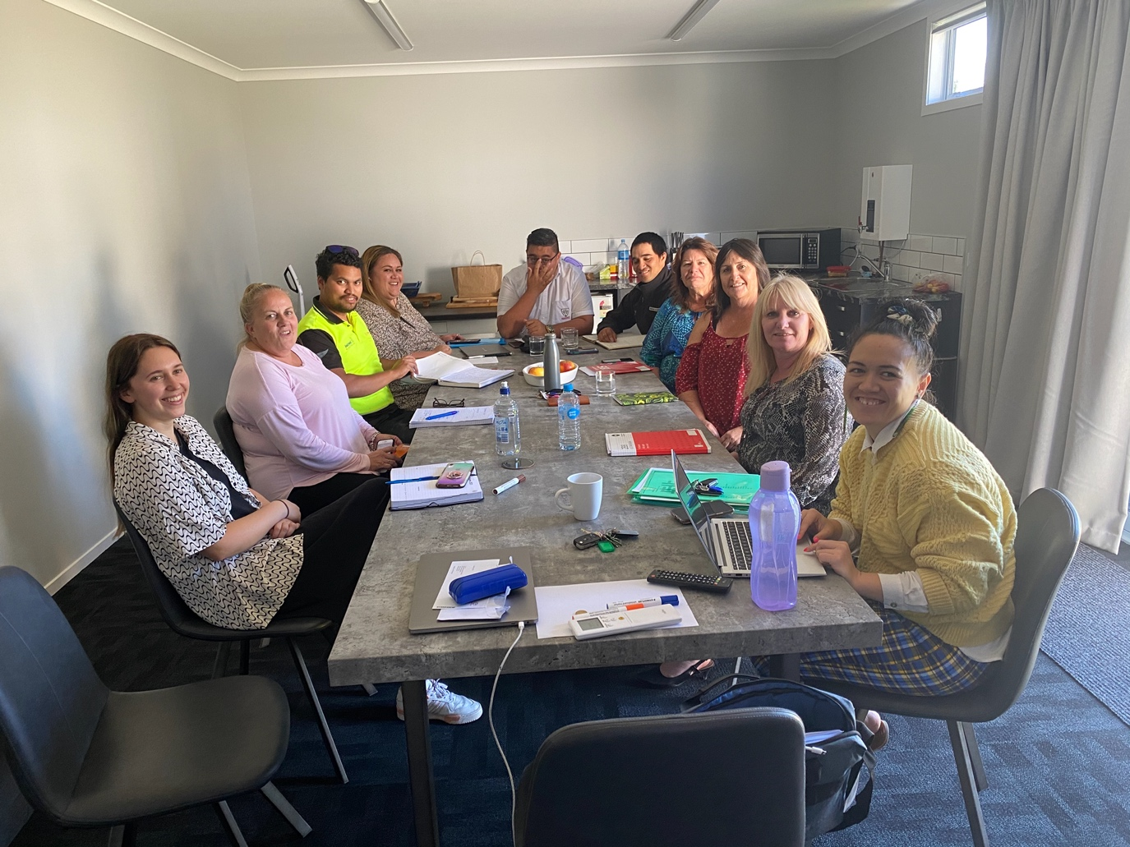

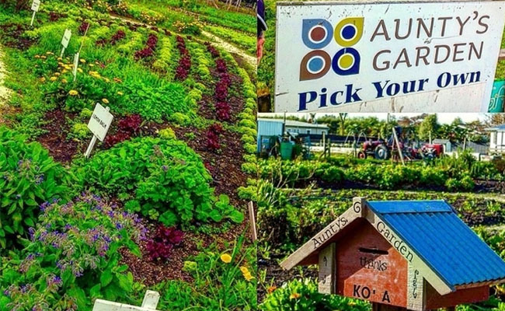
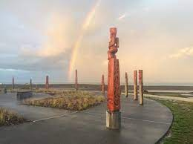
Papakāinga: is a collective of homes on ancestral whenua where whānau live independently in their own whare but collectively operate their papakāinga.
Hurunui-o-Rangi Papakāinga. Gladstone, Wairarapa
PukeAute Papakāinga – Te Hauke
Sheeran Associates LTD – Cadets learning Te Reo Māori
Cadetship programme: is to support Māori cadets to become highly skilled in their industry, through qualifications, knowledge, cultural awareness and employability of the cadet.
Ātea a Rangi Star compass - Matariki
Te Pū Harakeke Fund: is a fund to support Māori to host community projects and events, including Matariki and developing Māra Kai and sponsorship.
Sponsorship – support Māori events
Aunty’s Māra kai - 2022

Slide 49
Funding HQ

Slide 63

Thanks for coming and tuning in online!
A recording will be on the chbdc.govt.nz website search Grants and Funding

